Slide 1
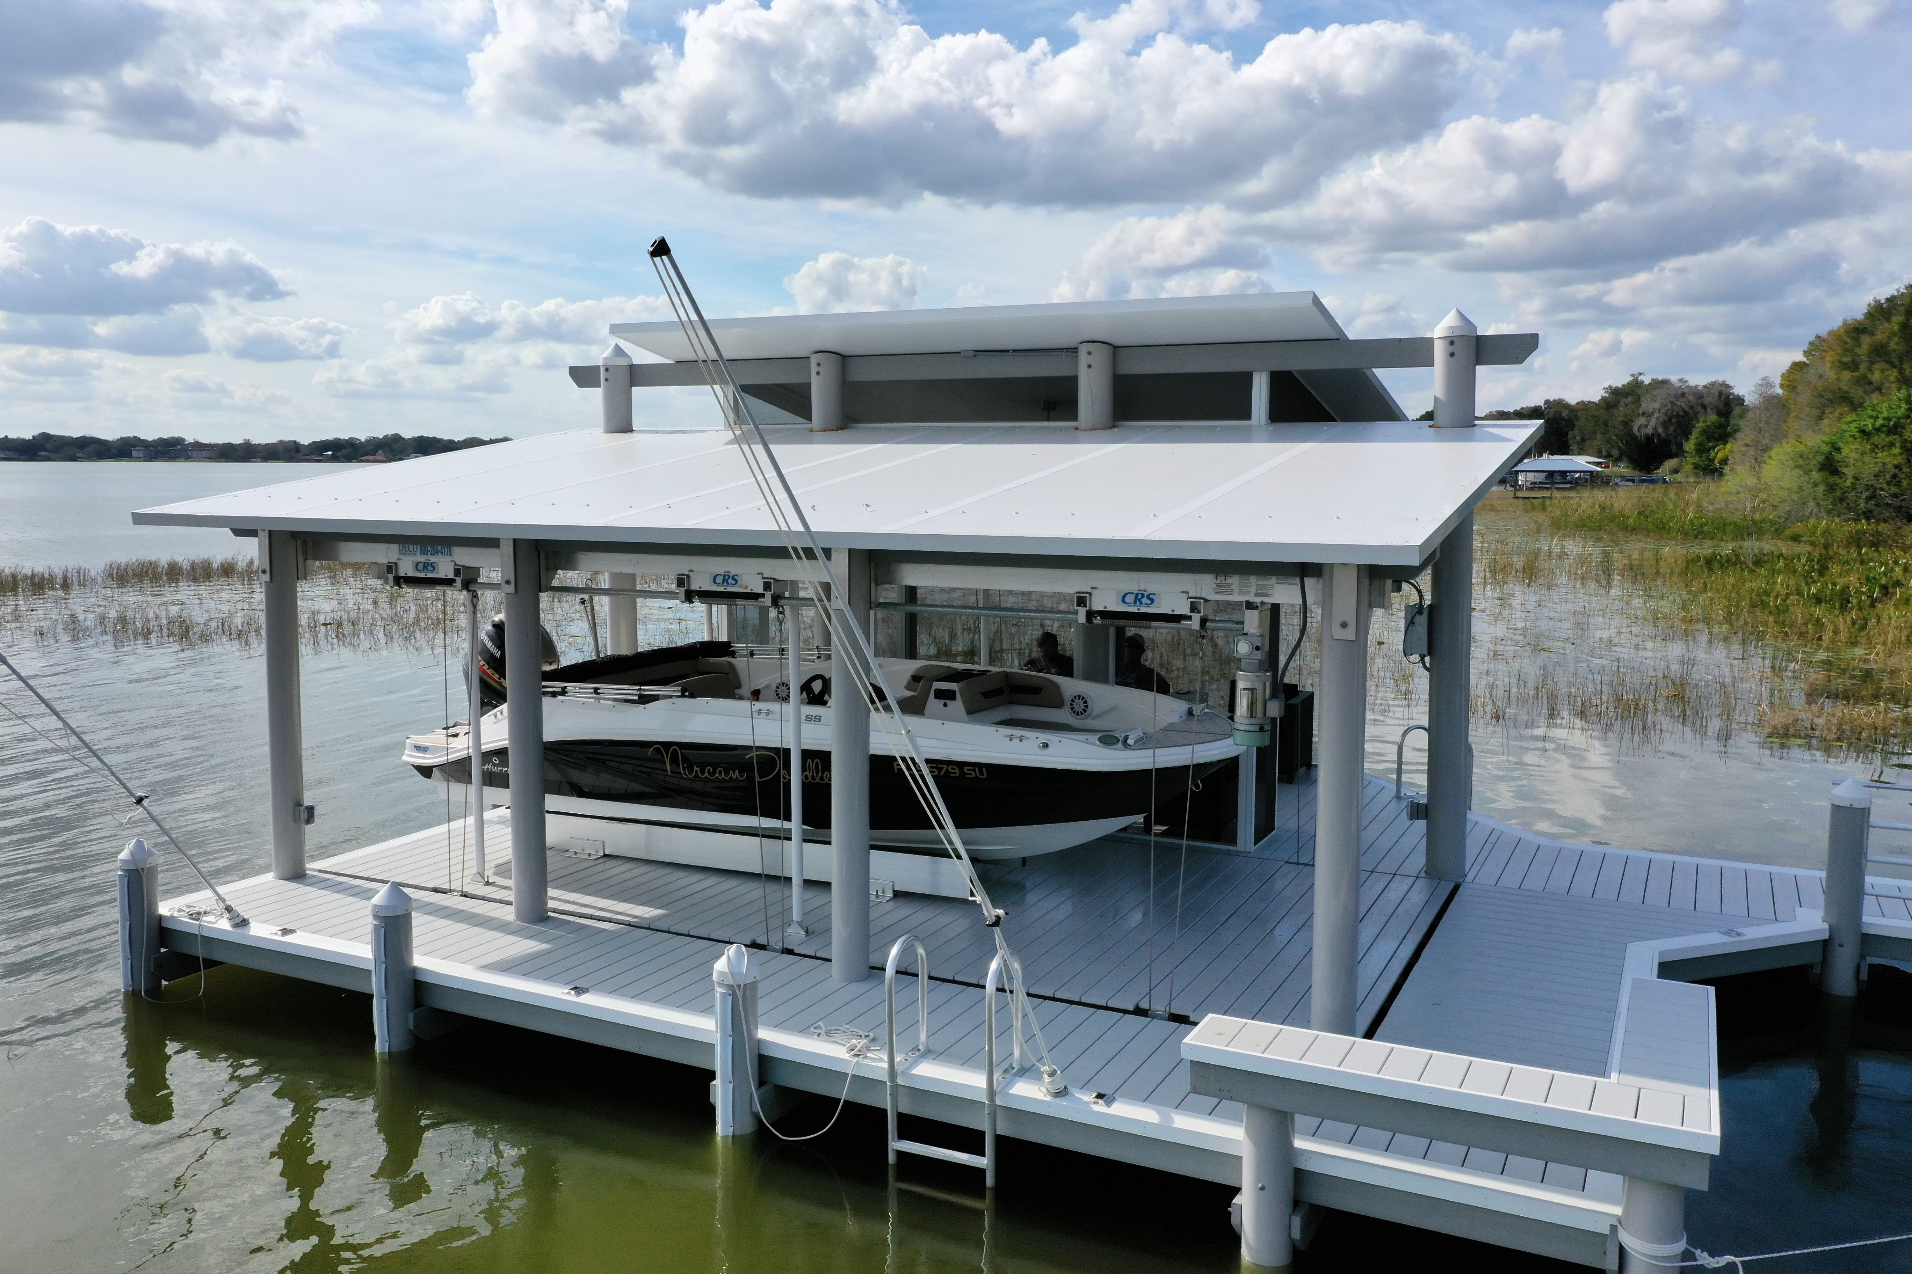

VENDOR TRAINING
MASTER HALCO
PRESENTER
FOR
Austin Porter
Master Halco
VP Sales & Marketing
Florida · April 28, 2026
OPENING
/
SHORELINE × MASTER HALCO

Slide 2
// OUR MISSION
sustainable composites that outlast and outperform wood
FOUNDED
PRICE POINT
18 years · Jacksonville, FL since 2008. USA-made composite extrusion built around marine-grade durability.
Around half the cost of comparable 100% solid fiberglass — attainable for residential and light commercial, not just heavy infrastructure.
RECYCLED CONTENT
SAME TOOLS
Up to 10 lbs of recycled PVC reused per linear foot of EcoPile. 100% recyclable at end-of-life.
Drop-in replacement for wood. Same standard tools, same crew, no specialty equipment required.
OPENING
/
WHY SHORELINE

Slide 3
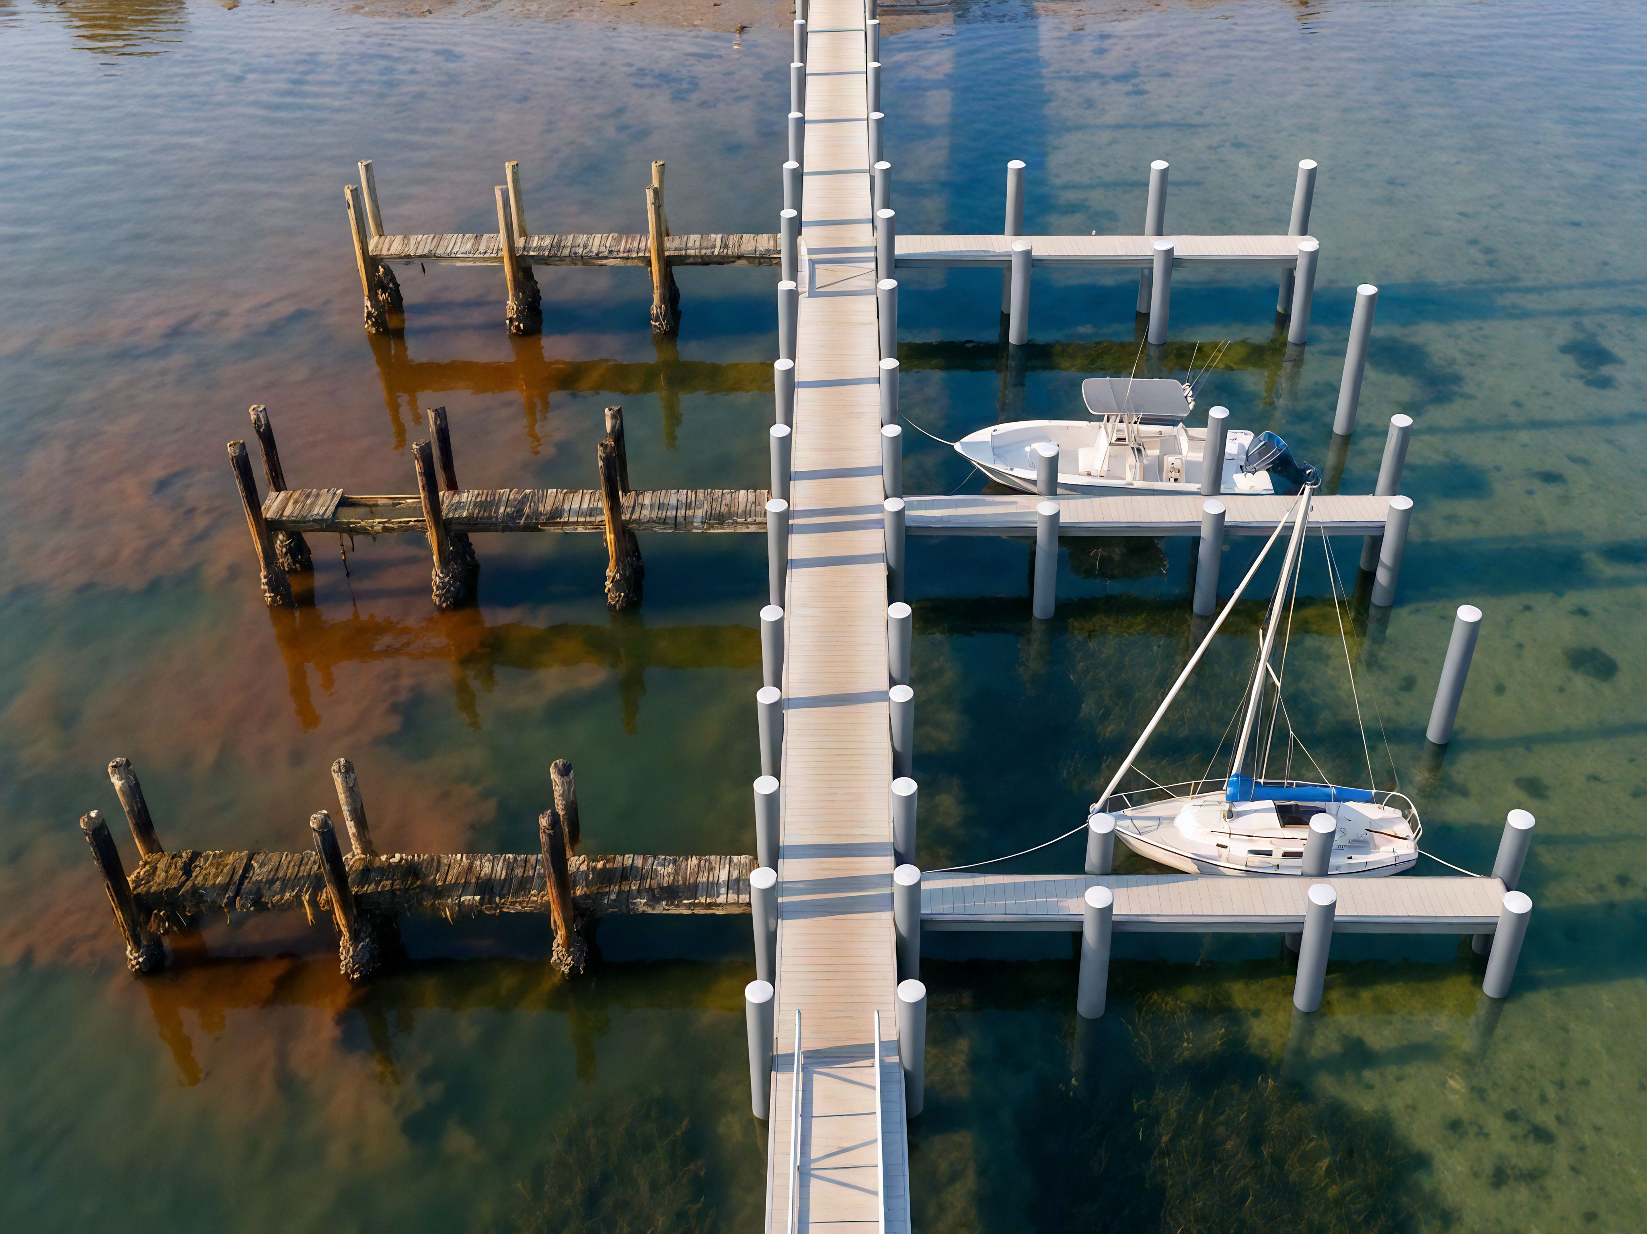
// WOOD IS FAILING FASTER
NOW THEY FAIL IN HALF THAT.
THEN · PRE-2003
30+ YRS
NOW · MODERN WOOD
< 15 YRS
REASON 01
REASON 02
Modern timber is grown faster — less dense, weaker.
EPA limits on CCA treatment — less protection than your customers' parents installed.
OPENING
/
LIFESPAN COLLAPSE

Slide 4
// THE PLATFORM
THREE OF FOUR · IN TODAY'S TRAINING
~½ the cost of solid fiberglass · USA-made · Jacksonville, FL
01 · FLAGSHIP
02 · REPAIR & RETROFIT
03 · PREVIEW
ECOPILE
SNAPJACKET
SEAWALL
Vinyl-fiberglass composite structural piling. Drop-in replacement for wood with standard tools.
Patent-pending PVC clamshell repair jacket. Restores piles in place — no demo, no crane.
EcoWall + KingPile. Fiber-reinforced sheet panels at ~2× the allowable moment of competitors.
50-YEAR WARRANTY
25-YEAR WARRANTY
PRODUCTIZATION MATURING
PLATFORM
/
FOUR PRODUCTS

Slide 5
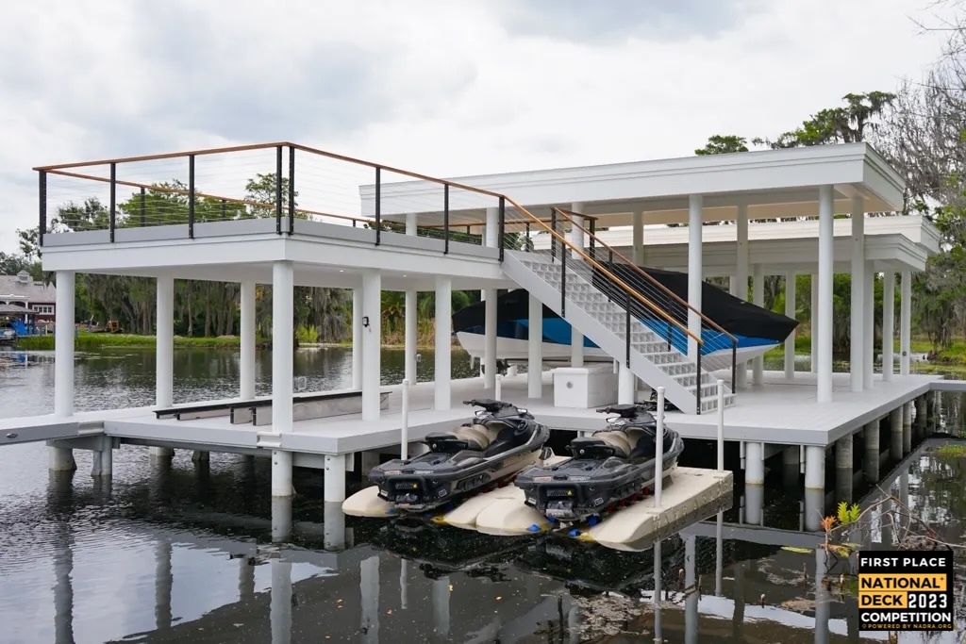

SECTION 02
THE WORKHORSE.
Vinyl-fiberglass composite structural piling. Drop-in for wood. The flagship product.
ECOPILE
/
SECTION OPEN

Slide 6
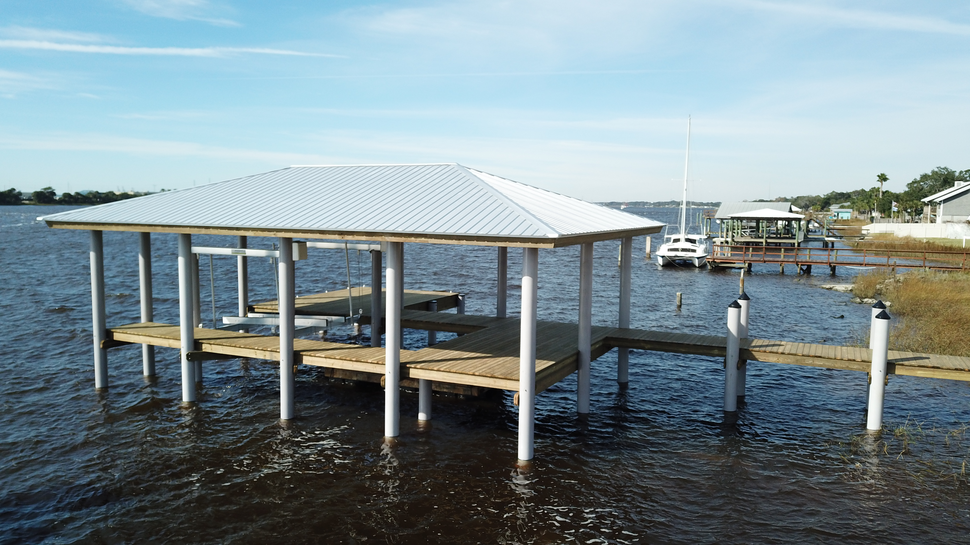
// ECOPILE · THE PROMISE
// WHY ECOPILE
PILING AGAIN.
01
50-year written warranty.
02
Storm-proven.
The piling is the foundation of the dock. If your pilings fail, the whole structure goes.
03
Drop-in for wood.
04
Recycled content.
Why spend the extra money on a deck with a 25-year warranty on a foundation that will hardly last half of that?
ECOPILE
/
TAGLINE

Slide 7

// ANATOMY · REVEAL
ULTRA HIGH IMPACT
UV/IR-resistant outer skin. Smooth medium-gray PVC.
SPECIALIZED CAPSTOCK
FIBERGLASS-COMPOSITE
10 lbs recycled PVC
> 200% MORE RIGID
~25% STIFFER · NEW FORMULATION
~40% stiffer
ECOPILE
/
ANATOMY

Slide 8
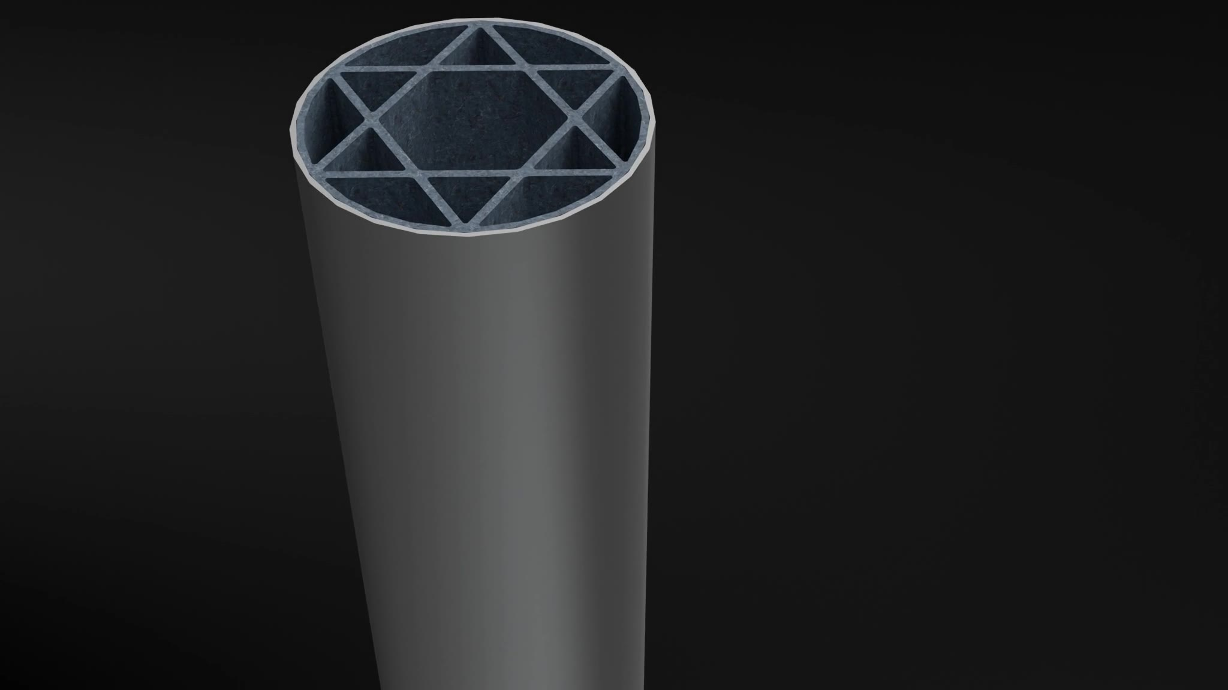
// INSIDE THE POLE
INTERNAL TRUSS.
A six-point star webbing runs the full length of the pile. Triangulated cross-section gives EcoPile structural rigidity far beyond a hollow pipe.
ENHANCED STIFFNESS
EASIER HANDLING
Often called a “Star of David” cross-section
ECOPILE
/
HEXAGRAM TRUSS

Slide 9
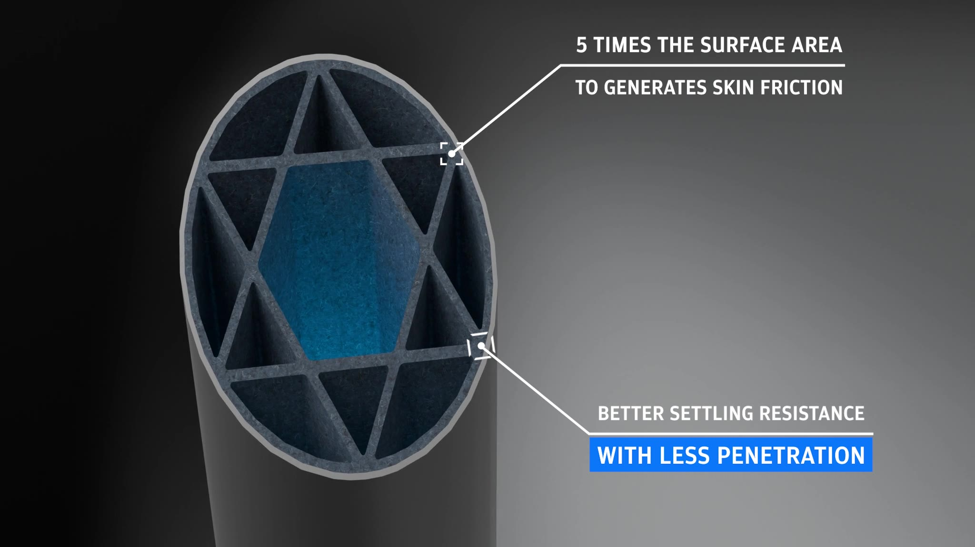
// CROSS-SECTION
5× THE SURFACE AREA
TO GENERATE SKIN FRICTION
BETTER SETTLING RESISTANCE
WITH LESS PENETRATION
SPIRAL RETENTION GROOVES · 5× MORE GRIP THAN SMOOTH
ECOPILE
/
CROSS-SECTION

Slide 10
// PROOF · STORM RESILIENCE
POLES IN THE STORM.
// HURRICANE SALLY · PENSACOLA
+
PLACEHOLDER
EcoPile dock · post-storm intact
ECOPILE POLES IN THE WATER
CONFIRMED LOSSES
ZERO
PLACEHOLDER
Concrete-pile damage · contrast
“Out of the 2,000+ poles in the early days, we didn't lose a single piling we were aware of.”
— TRIDENT MARINE, TAMPA
// SURROUNDING PROPERTIES
completely wiped out.
ECOPILE
/
HURRICANE SALLY

Slide 11
// SIZING · RULE OF THUMB
8 · 10 · 12 · 14 INCH.
use 10" EcoPile where you'd use 8" wood.
″
″
″
″
TYPICAL USE
TYPICAL USE
TYPICAL USE
TYPICAL USE
Walkway pilings or boathouses in protected, shallow water — lakes & sheltered coves.
Deeper-water walkways, terminal platforms, small lifts and boathouse roofs.
Boathouse pilings, larger lift poles — anything freestanding with significant loading.
Heavy commercial, channel markers, structural — anything you want to throw at it.
DIAMETERS
STANDARD LENGTHS
CUSTOM LENGTHS
COLOR
8 · 10 · 12 · 14″
16 · 20 · 31 · 36 ft
ON REQUEST
GRAY STD
ECOPILE
/
SIZING

Slide 12
// ECOPILE · FOUR NUMBERS WORTH KNOWING COLD
50-YEAR. 10-POUND. 8-YEAR. 25-PERCENT.
YR
LB
YR+
%
WRITTEN WARRANTY
RECYCLED PVC · PER LIN. FT.
IN THE FIELD
RIGIDITY · NEW FORMULATION
Only piling on the market with one.
A 30-ft pile = ~300 lbs kept out of waterways.
Multiple national building awards on EcoPile projects.
New 12″ wall: ~40% stiffer than the prior 12″.
Around half the cost of comparable 100% fiberglass pilings. Same standard tools as wood.
ECOPILE
/
PROOF POINTS

Slide 13
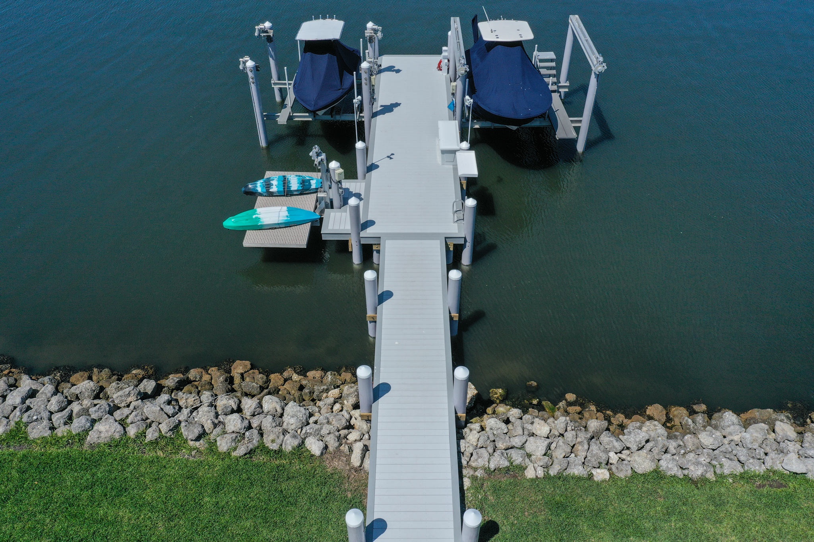
// SECTION RECAP
OVERVIEW.
The workhorse — what to remember when you walk back to your customers.
YR
%+
0
WRITTEN WARRANTY
CONFIRMED LOSSES · HURRICANE SALLY
MORE RIGID THAN COMPETITORS
The only piling on the market with one. It closes the contractor.
2,000+ EcoPile poles in the water at Pensacola. Surrounding wood & concrete docks were destroyed.
Hexagram truss runs the full length — six-point star, not a hollow pipe.
×
×
USA
SKIN FRICTION VS WOOD
COST OF SOLID FIBERGLASS
JACKSONVILLE, FL
Better settling resistance, less penetration depth required.
Attainable for residential & light commercial — not just heavy infrastructure.
Drop-in for wood. Same crew, same standard tools. Sizes 8 · 10 · 12 · 16″.
ECOPILE
/
SECTION RECAP

Slide 14

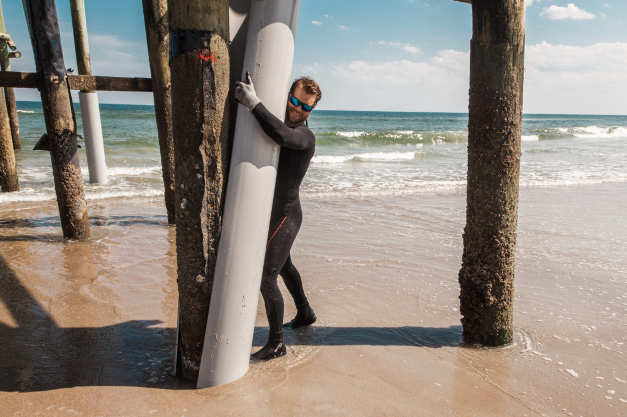
SECTION 03
IN PLACE.
Patent-pending PVC clamshell jacket. Restores structural integrity without removing the deck.
SNAPJACKET
/
SECTION OPEN

Slide 15
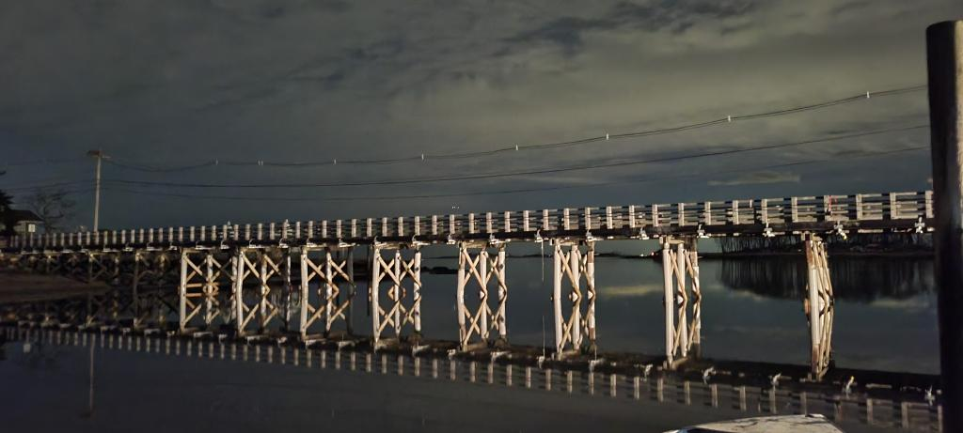
// SNAPJACKET · THE PAIN
// FULL REPLACEMENT
Mobilize a barge and crane to swap a few piles. Demolish the deck above. Five-figure job for residential.
UNTIL NOW.
// SNAPJACKET
Slip the jacket around the existing pile. Lock. Fill with concrete. Deck stays. Boat stays. Two-person crew, hand tools.
// TAGLINE
“The longest-lasting affordable solution to fix decaying pilings.”
SNAPJACKET
/
THE PAIN

Slide 16
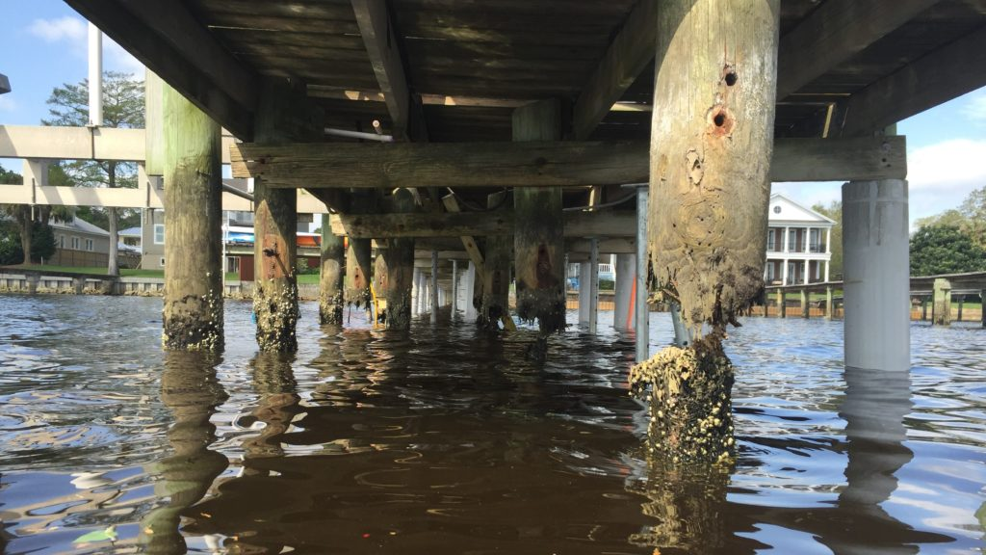
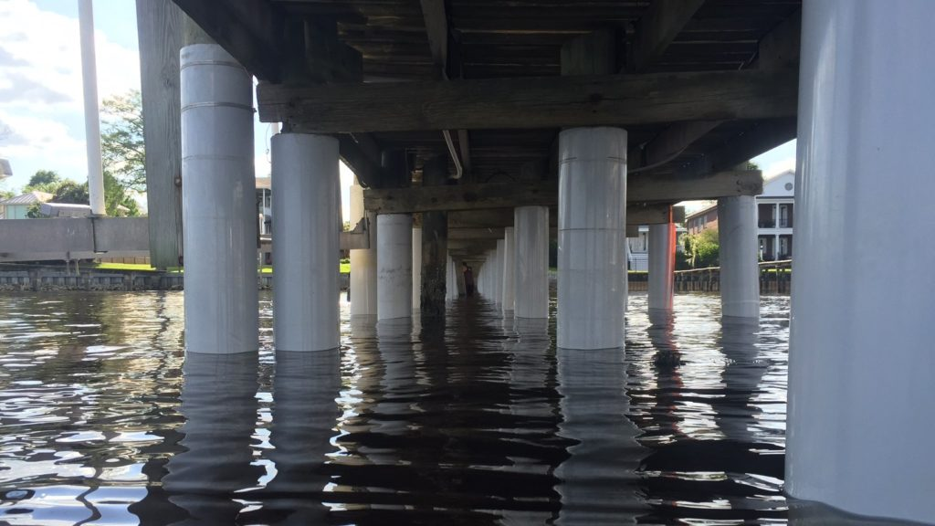
// SAME DOCK · SAME CREW
BEFORE · AFTER.
BEFORE
BEFORE · MARINE BORERS · ROT
AFTER · SNAPJACKET INSTALLED
CRANES
BARGES
DECK REMOVED
WARRANTY
0
0
NONE
25-YEAR · ENGAGED INSTANTLY
SNAPJACKET
/
BEFORE · AFTER

Slide 17
// INSTALL · 4 STEPS
SLIP · DRIVE · LOCK · FILL.
01
02
03
04
SLIP
DRIVE
LOCK
FILL
8 to 12 inches below mudline
Slide the patent-pending locking mechanism down the seam. Watertight seal — blocks sun, oxygen, marine borers.
Without removing any deck above.
25-year warranty engages instantly.
SNAPJACKET
/
INSTALL

Slide 18
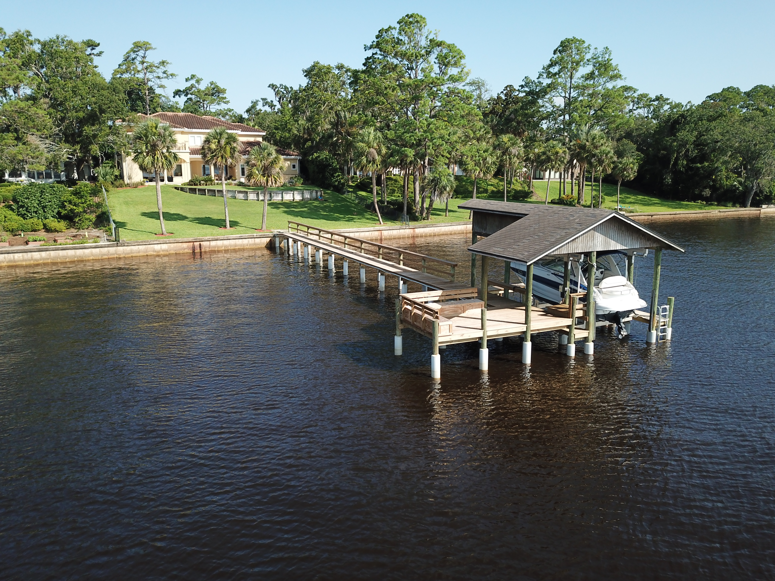
// INSTALL · TOOLS
01
SAFETY GLASSES + PFD
No cranes. No barges. No track hoes. No specialty equipment.
02
BUCKET + SHOVEL
03
CONCRETE / TYPE-M MORTAR
04
SAWZALL · FINE-TOOTH
05
POWERWASHER
+
RATCHET STRAP · OPTIONAL · LARGER JACKETS
SNAPJACKET
/
TOOLS

Slide 19
// SPECS · ENGINEERING TRUST
SAME PVC CHEMISTRY AS DRINKING-WATER SYSTEMS.
YR
YR+
// SIZING CHEAT-SHEET
WARRANTY
1.5–2″
UV EXPOSURE RATING
As strong or stronger than the original piling.
Same compound as vinyl siding & vinyl windows.
61
6″ pole
→ 10″ jacket
0
10″ pole
→ 14″ jacket
POTABLE-WATER RATED
FLAME SPREAD INDEX
*
Zero leaching. Zero lead.
14″ pole
Does not support combustion. Microbiologically immune.
JACKET DIAMETERS · LENGTHS
10 · 12 · 14 · 16″ · 7.5 ft std · custom on request
SNAPJACKET
/
SPECS & SIZING

Slide 20
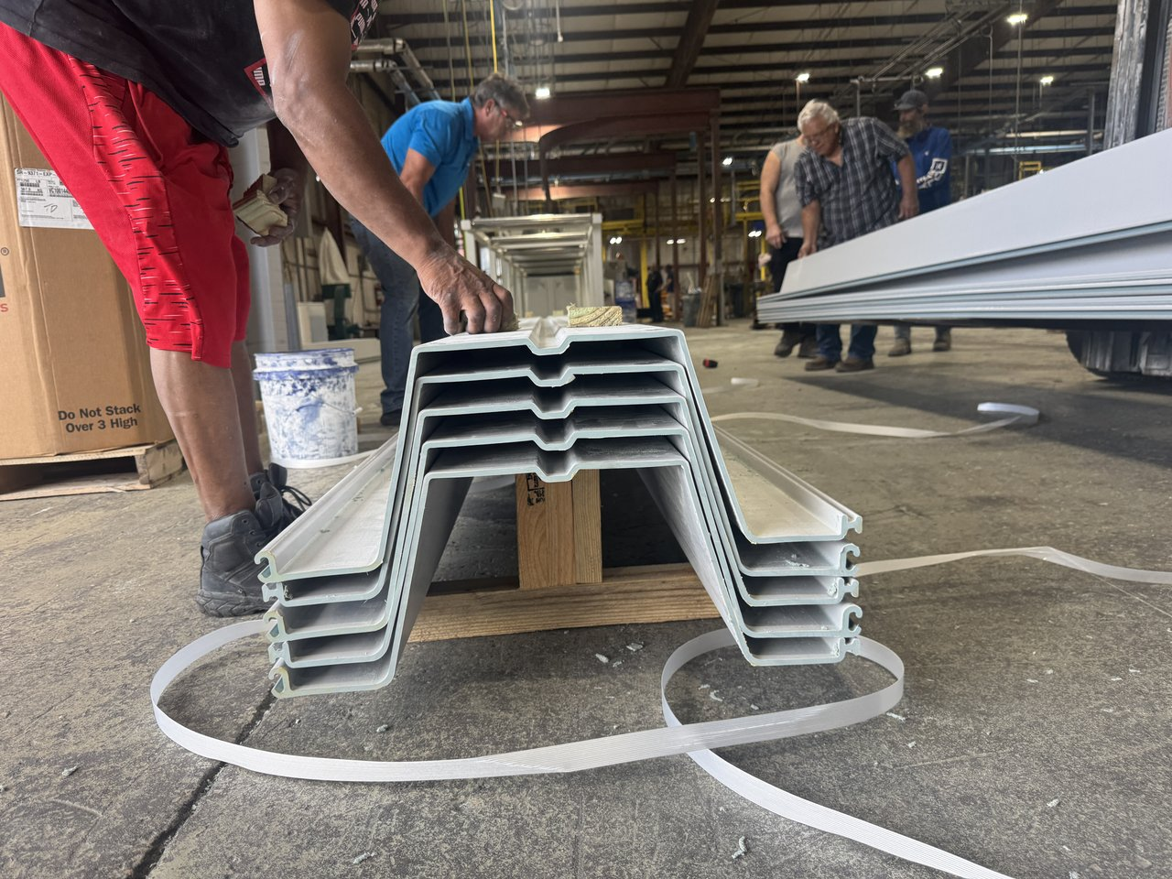

SECTION 04 · PREVIEW
NEXT.
Roadmap conversation, not a Tuesday close. Productization is maturing — but the engineering is here, and the channel discussion starts today.
ECOWALL
/
SECTION OPEN

Slide 21
// ECOWALL · ALLOWABLE MOMENT
~2× THE ALLOWABLE MOMENT.
ESP 3.1
3,129
competitor
★ ECOWALL 24.250
5,979
+102% · +91%
SG-325
2,960
competitor
UNIT
PARITY
TAKEAWAY
allow
All three at 0.25" thickness
Same shipping, same handling, more performance.
ECOWALL
/
ALLOWABLE MOMENT

Slide 22
// HOW TO SELL · HOW TO ORDER
CHANNEL CHEAT-SHEET.
PRODUCT
FULFILLMENT
QUOTE TURNAROUND
TYPICAL CUSTOMER
ECOPILE
GREAT SOUTHERN
1–3 days · common stock lengths in gray
Marine contractors
SNAPJACKET
DIRECT FROM SHORELINE
(production capacity increasing)
Smaller-scale marine contractors · homeowners / DIYers
ECOWALL
TBD
1–2 weeks · test projects
Marine contractors
// WORKFLOW
// TECHNICAL ESCALATION
// PRICING + CONTACTS
→
→
Routes through Shoreline. Hands-on, not transactional.
In the leave-behind. Not on these slides.
CHANNEL
/
HOW TO SELL & ORDER

Slide 23
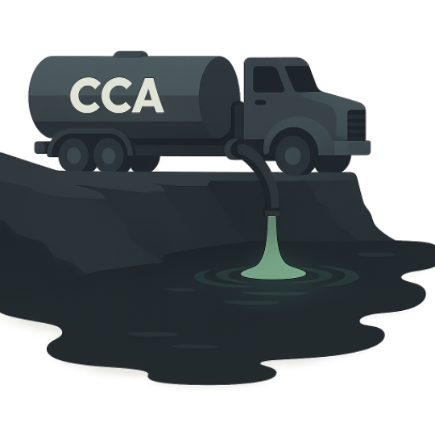
// WHY NOW
CCA INTO FLORIDA WATERWAYS · ANNUALLY
2.5M
GALLONS
2003 · THE BAN
EPA bans CCA-treated wood for general consumer use — decks, playgrounds, picnic tables. Marine carve-out preserved because no cost-effective alternative existed.
Roughly two tank trucks of CCA dumped into Florida waterways every single day.
TODAY · THE SHIFT
That alternative exists — it's what we make. Multiple states have already banned any treated lumber in contact with water. The regulatory baseline is shifting, and contractors are starting to feel it.
CLOSING
/
WHY NOW

Slide 24
MODERNIZE THE SUBSTRATE.
OUTLAST THE ELEMENTS.
QUESTIONS · LEAVE-BEHIND · TECHNICAL LINE
Shoreline Plastics · Jacksonville, FL · shorelineplastics.com

